Slide 1

Predicting Sentiment on Flipkart Reviews with Machine Learning

Slide 2
CONTENTS:
Introduction
Technologies
What is sentiment analysis?
Modules description
Results and future directions
Why is sentiment analysis important for Flipkart?
Gantt chart

Slide 3
Introduction
In today's digital age, online reviews have become an integral part of our decision-making process. Whether we are purchasing a product or choosing a service, we often rely on reviews to guide us. However, with so many reviews available, it can be challenging to sift through them all. This is where sentiment analysis comes in.
Sentiment analysis is the process of using natural language processing and machine learning techniques to identify and extract subjective information from text. In other words, it allows us to determine whether a review is positive, negative, or neutral. By analyzing the sentiment of reviews on Flipkart, we can gain valuable insights into customer satisfaction and make data-driven decisions to improve the overall customer experience.

Slide 4
Technologies
Software requirements
Anaconda is a hearty platform for the ML Ops life cycle, and is used by the likes of American National Bank, AT&T, Toyota, and Goldman Sachs. Standard features include a Conda package manager, unlimited commercial packages and bandwidth, a mirrored or cloud-based repository, and an environment manager. Their Individual subscription tier is perfect for freelancers: free to use, thousands of open-source packages and libraries, and 7500+ Conda packages.
Hardware requirements CPU: 2 x 64-bit, 2.8 GHz, 8.00 GT/s CPUs or better. Verify machine architecture. Memory: minimum RAM size of 32 GB, or 16 GB RAM with 1600 MHz DDR3 installed, for a typical installation with 50 regular users.

Slide 5
What is sentiment analysis?
Sentiment analysis, also known as opinion mining, is the process of using natural language processing and machine learning techniques to identify and extract subjective information from text data.
In simpler terms, sentiment analysis is a way to understand the emotions and opinions expressed in written text, such as product reviews on Flipkart. By analyzing the sentiment of these reviews, we can gain valuable insights into customer satisfaction and preferences.

Slide 6
Modules Description
The "Flipkart Reviews Extraction and Sentiment Analysis" project encompasses several stages, each requiring specific research methodologies to ensure accuracy, reliability, and effectiveness. The methodology is structured as follows:
Data Collection: Web Scraping: Employ web scraping techniques using Python libraries such as Beautiful Soup and Selenium to collect product reviews from Flipkart's product listings. Develop scripts to navigate through pages, extract structured data including user names, review texts, ratings, and metadata.
Data Preprocessing: Text Cleaning: Remove HTML tags, special characters, and irrelevant information from the extracted reviews. Tokenization: Split reviews into tokens or words for further analysis. Stop word Removal: Eliminate common stop words that do not contribute significantly to sentiment analysis. Lemmatization or Stemming: Reduce words to their base forms to normalize the text.

Slide 7
Sentiment Analysis: Feature Extraction: Convert text data into numerical features using techniques like TF-IDF (Term Frequency-Inverse Document Frequency) or word embeddings likeWord2Vec or GloVec. Model Selection: Choose an appropriate sentiment analysis model, such as Support Vector Machines (SVM),Naive Bayes, or deep learning models like Convolutional Neural Networks (CNNs)or Recurrent Neural Networks (RNNs). Training and Testing: Split the dataset into training and testing sets for model training and evaluation. Hyperparameter Tuning: Optimize model hyperparameters for improved accuracy. Validation: Validate the model's performance through metrics like accuracy, precision, recall, andF1-score. Testing and Validation: Conduct comprehensive testing, including unit testing, integration testing, and system testing, to verify the system's functionality and validate the system's performance by using diverse product categories and reviews.
Ethical Considerations: Address ethical concerns related to web scraping and data usage, including privacy and consent. Comply with relevant legal and ethical guidelines and regulations governing data collection and analysis.
User Interface Development: Develop a user-friendly interface or dashboard to present the results of sentiment analysis. Utilize web frameworks like Flask or web visualization libraries to create interactive data displays.

Slide 8
Results and future directions
After conducting sentiment analysis on Flipkart reviews, we found that the majority of reviews were positive. However, there were also a significant number of negative reviews that highlighted areas for improvement in customer experience. By analyzing these reviews, we were able to identify specific pain points and make recommendations for improving customer satisfaction.
Moving forward, we plan to continue refining our machine learning models to improve the accuracy of sentiment analysis. We also plan to explore the use of natural language processing techniques to better understand the nuances of customer feedback. Ultimately, our goal is to provide Flipkart with actionable insights that can be used to enhance the overall customer experience.

Slide 9
Why is sentiment analysis important for Flipkart?
Sentiment analysis is crucial for Flipkart because it helps the company understand how customers feel about their products and services. By analyzing reviews and feedback, Flipkart can identify areas where they excel and areas where they need to improve. This information can be used to make informed decisions that will ultimately lead to a better customer experience.
Additionally, sentiment analysis can provide valuable insights into customer preferences and trends. By analyzing reviews and feedback, Flipkart can identify which products are popular and which ones are not. This information can be used to inform product development and marketing strategies, helping Flipkart stay ahead of the competition.
Overall, sentiment analysis is an essential tool for any business that wants to deliver a great customer experience. By understanding how customers feel about their products and services, businesses can make informed decisions that will ultimately lead to happier customers and increased revenue.

Slide 10
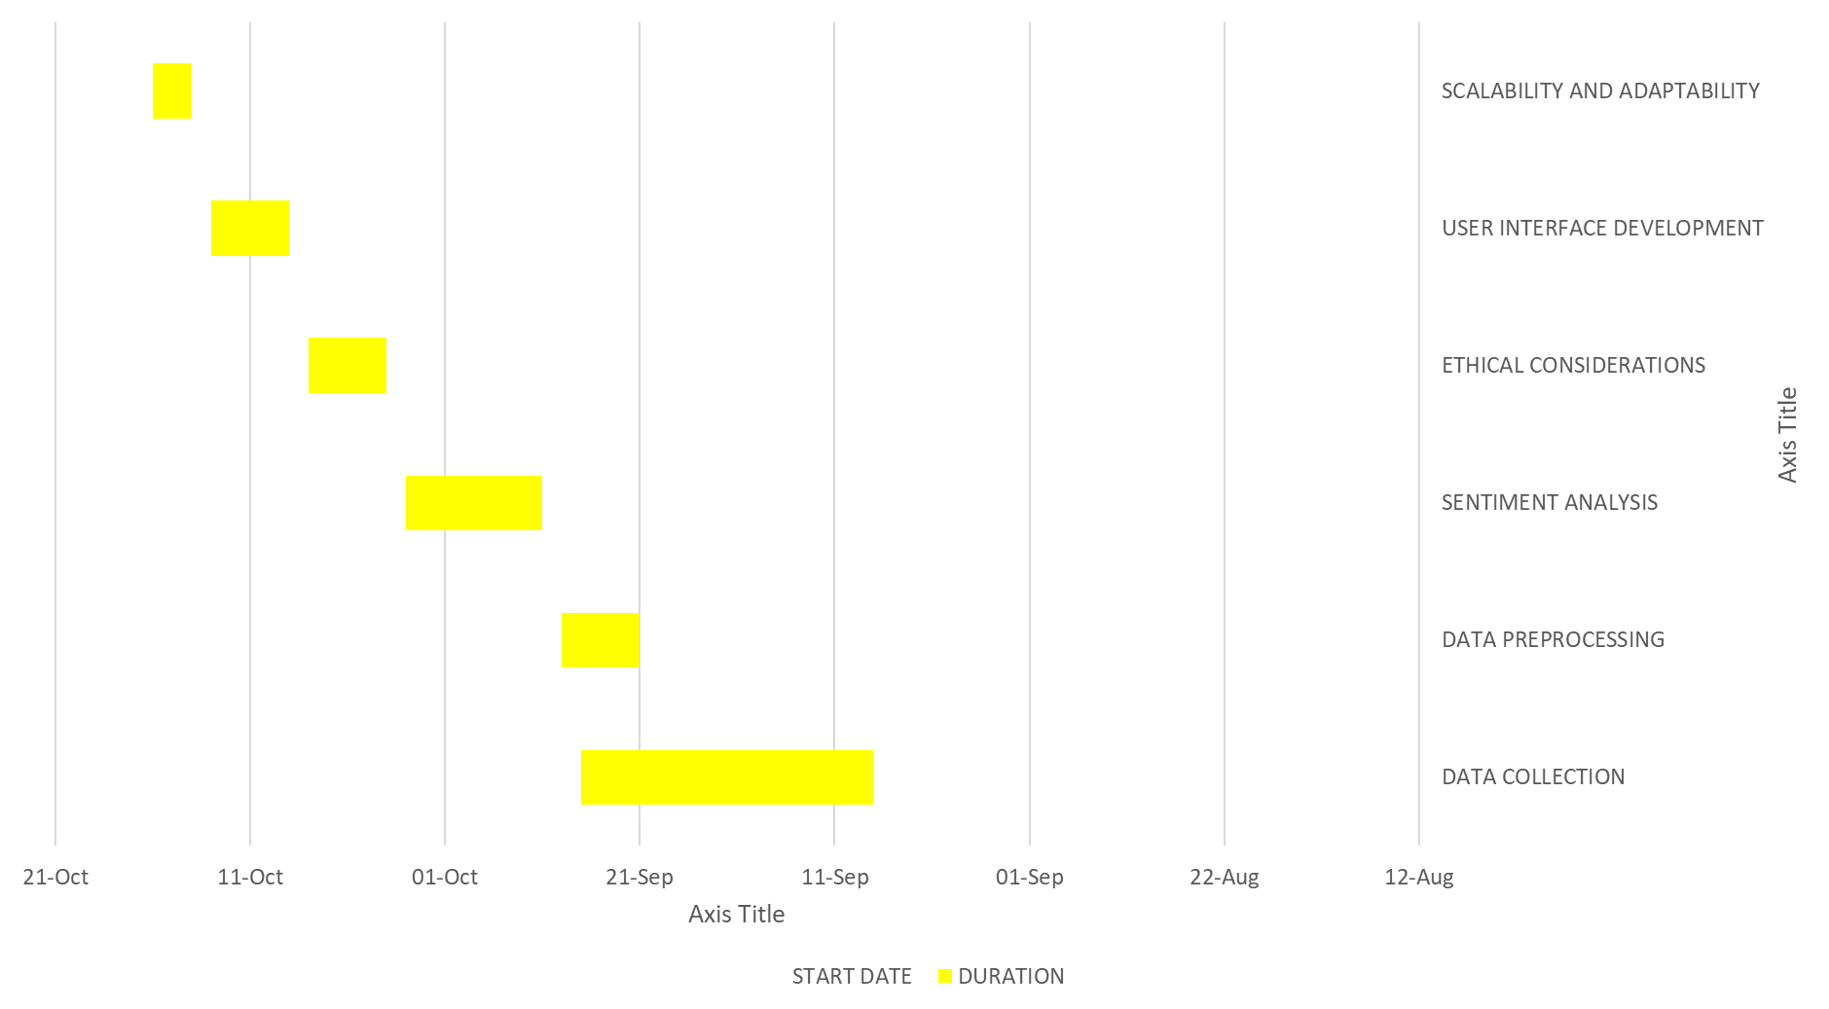
GANTT CHART

